Slide 1
Book Buddy Sprint 3 Update
Team 5 - Code Avengers
Pace University Capstone Project - Spring 2024

Slide 2
Agenda
Team Details
Improvements Made
Project Description
Working Agreement
Personas
Technologies
Algorithms
Diagrams
Product Backlog
Sprint 3 Backlog
Metrics
Retrospective
Sprint 4 Plans
Demo

Slide 3

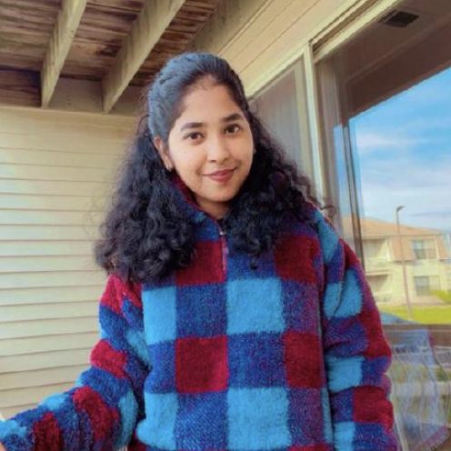

Team Members
Jimmy Karoly
Scrum Master/Developer
Dhanasri Salla
Machine Learning Engineer
Sai Sandeep Mandava
Machine Learning Engineer

Slide 4
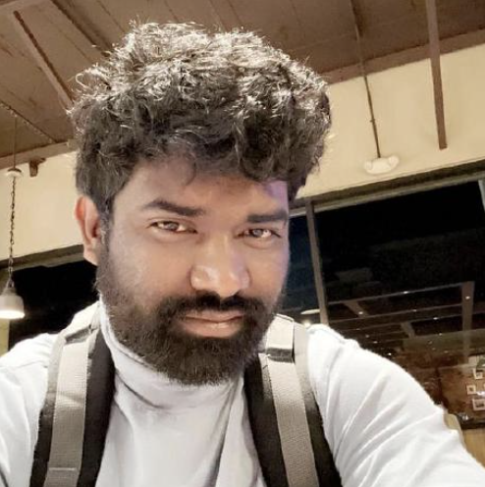


Team Members
Praveen Raj Gujju
Tester
Anusha Meka
Developer
Sairam Vinjamoori
Developer

Slide 5

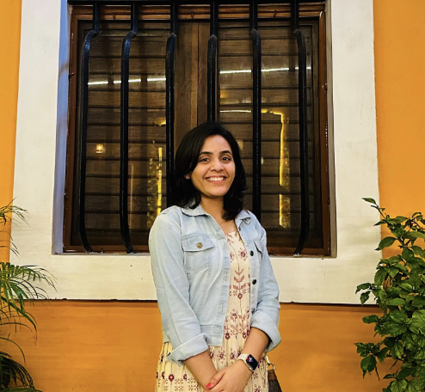
Team Members
Krushal Rama
Developer
Alekhya Bommineni
Developer

Slide 6
Changes due to Professor’s Feedback
Used correct story point numbers
Refined Product Backlog and split User Stories
Changed formats of Product Backlog/User Stories/Acceptance Criteria to make them more readable
Changed format of metrics slide to make it more readable
Reformatted Algorithm slide to make that more readable
Slides with changes have this icon:

Slide 7
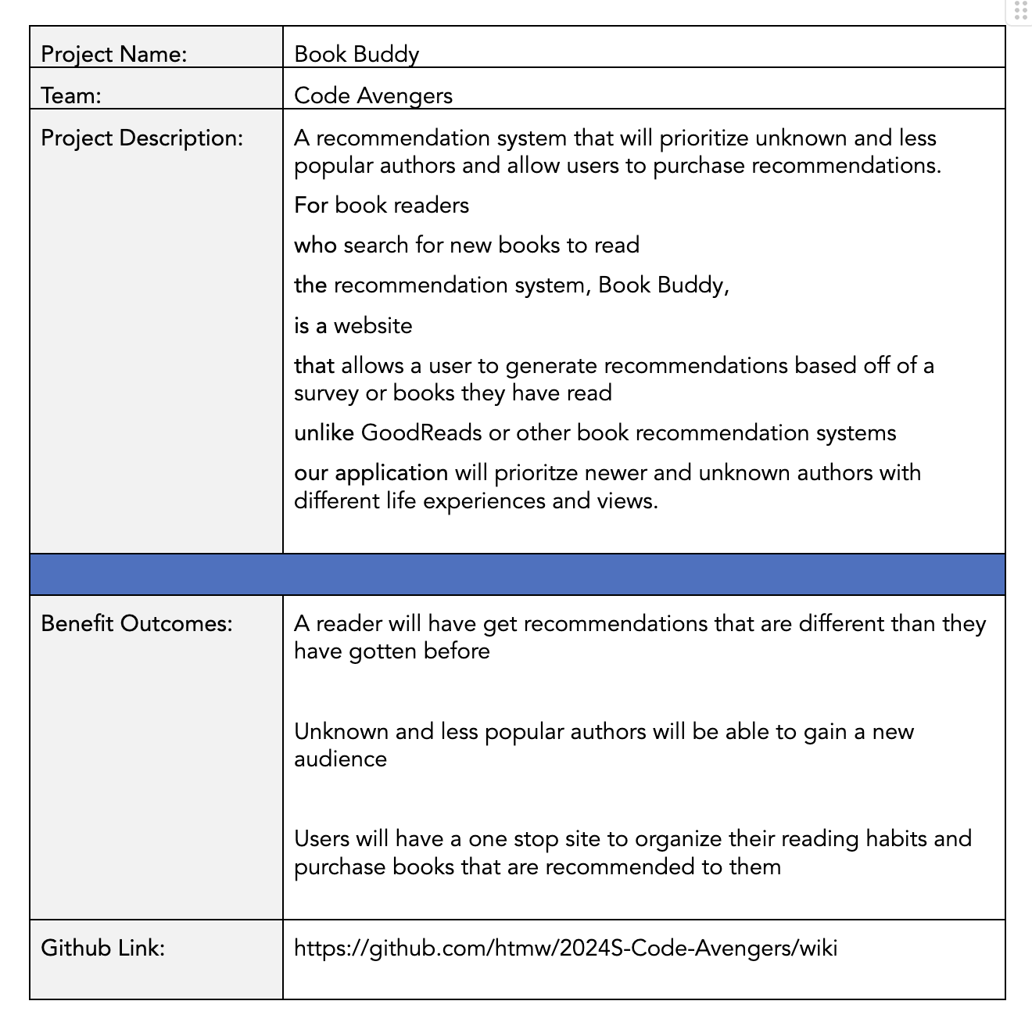
Project Description

Slide 8
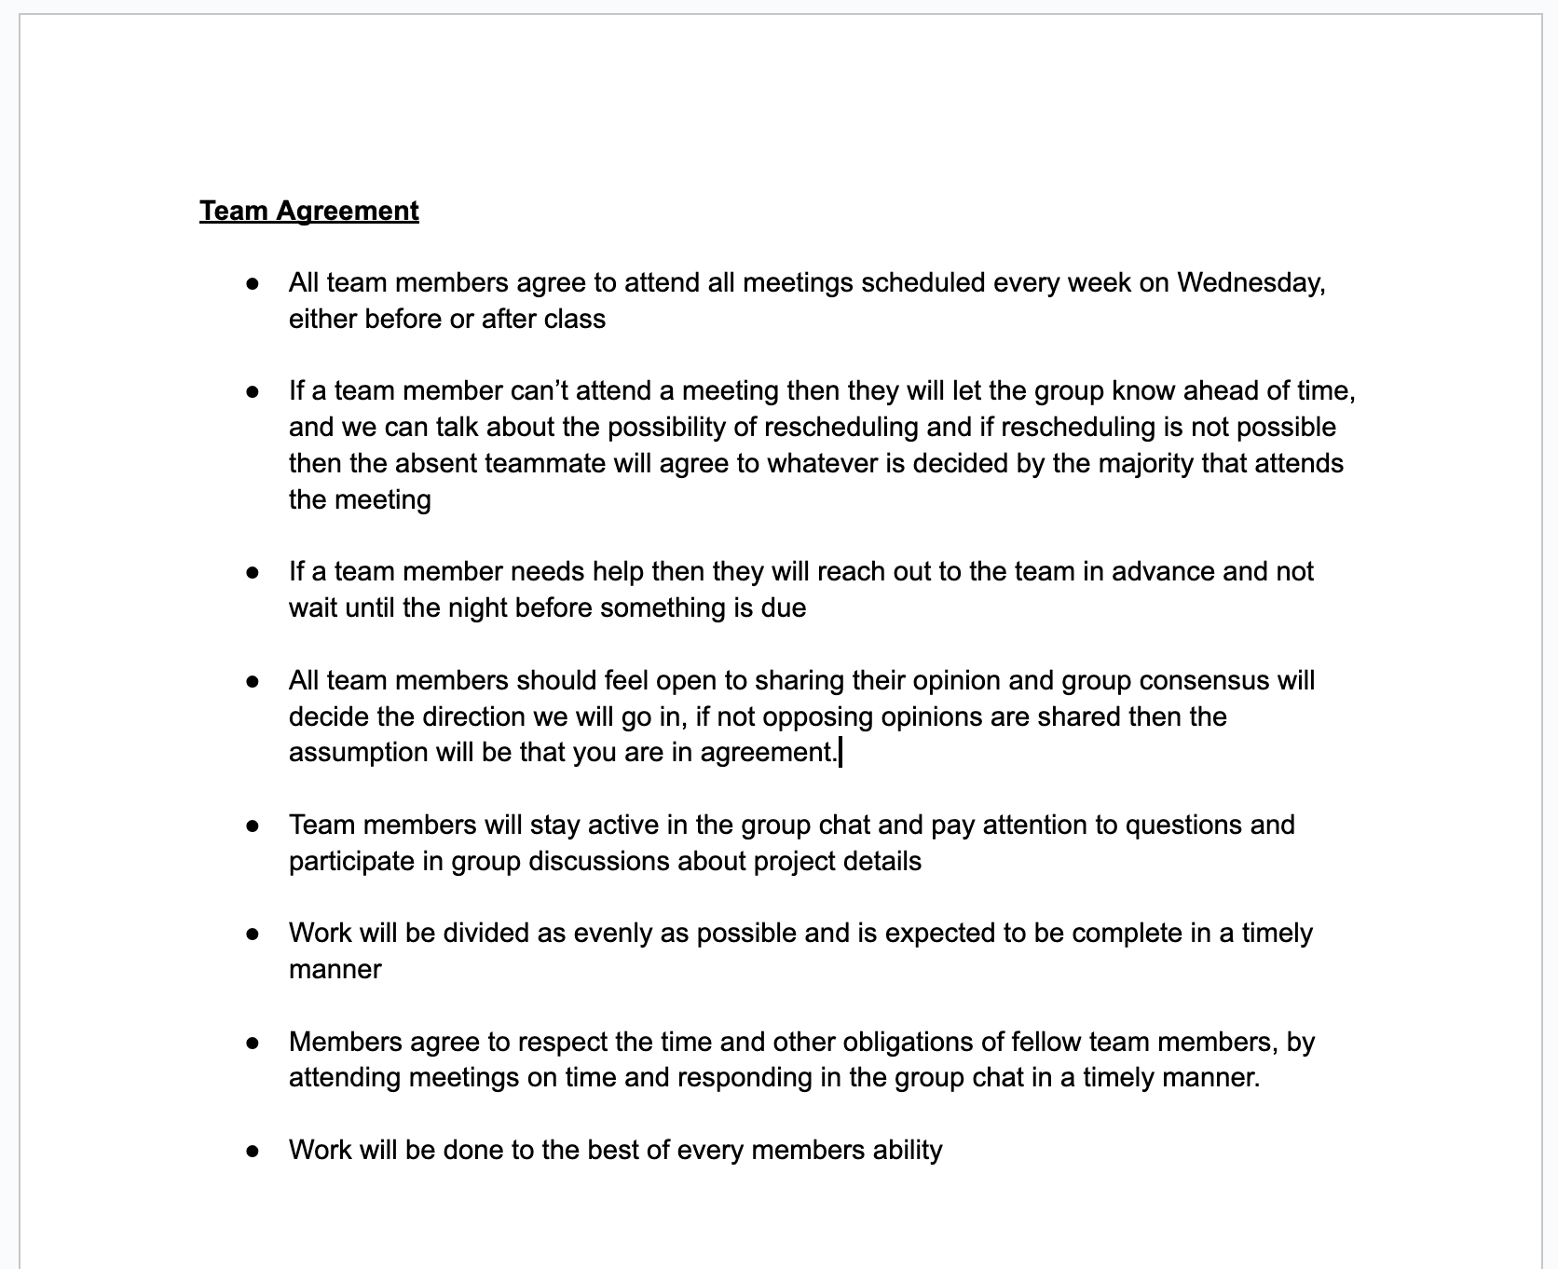
Team Working Agreement

Slide 9
Personas

Slide 10
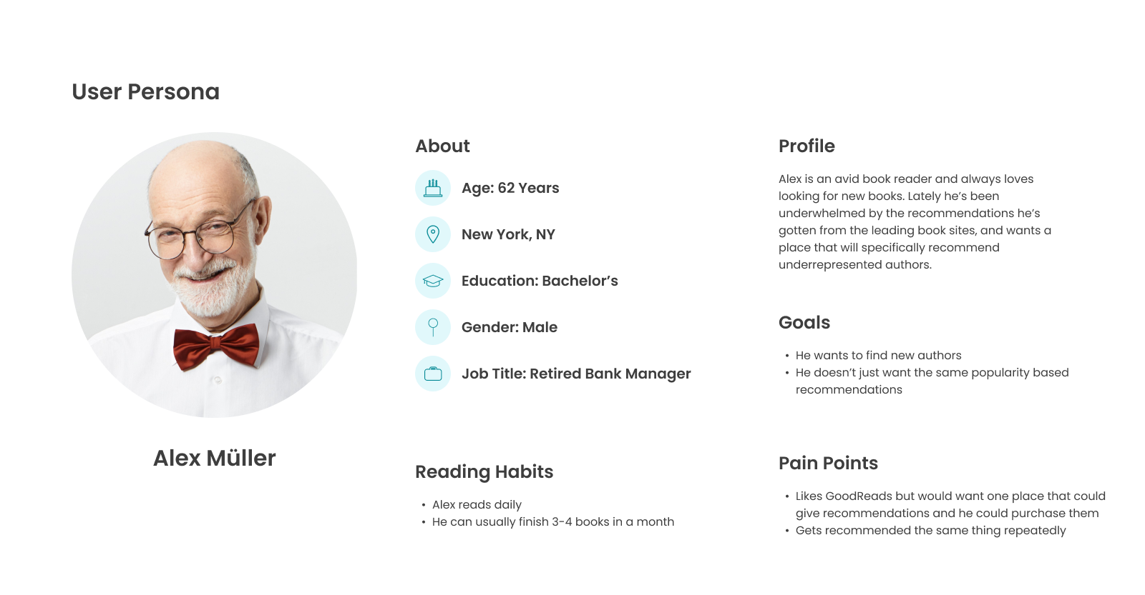

Slide 11
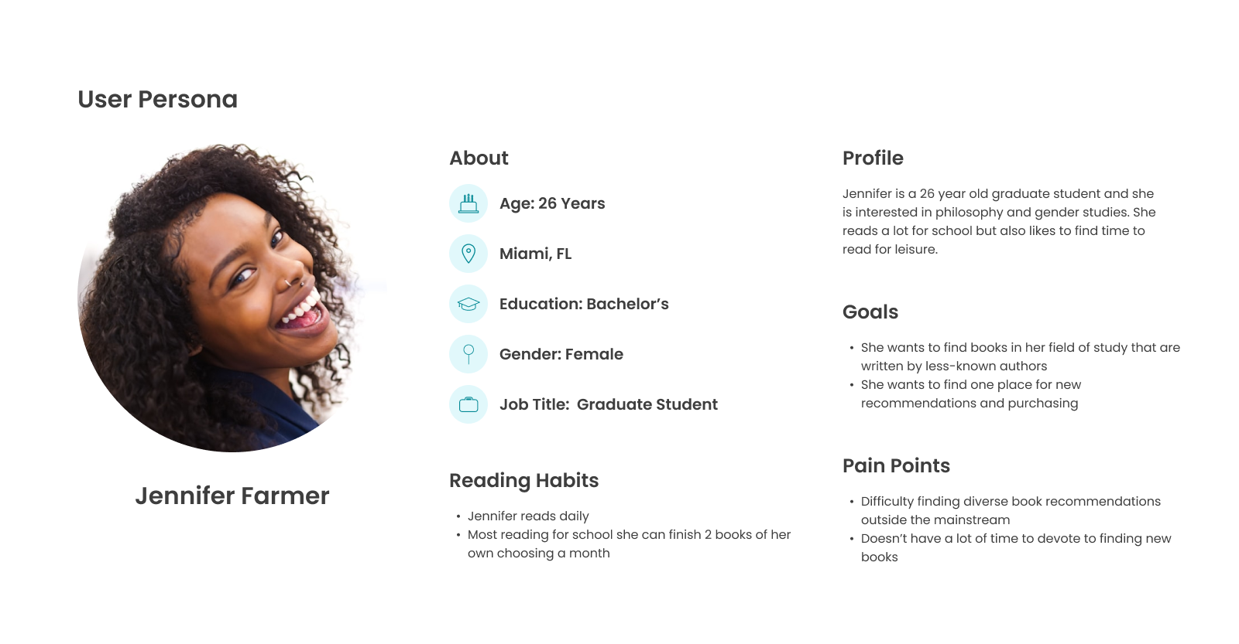

Slide 12
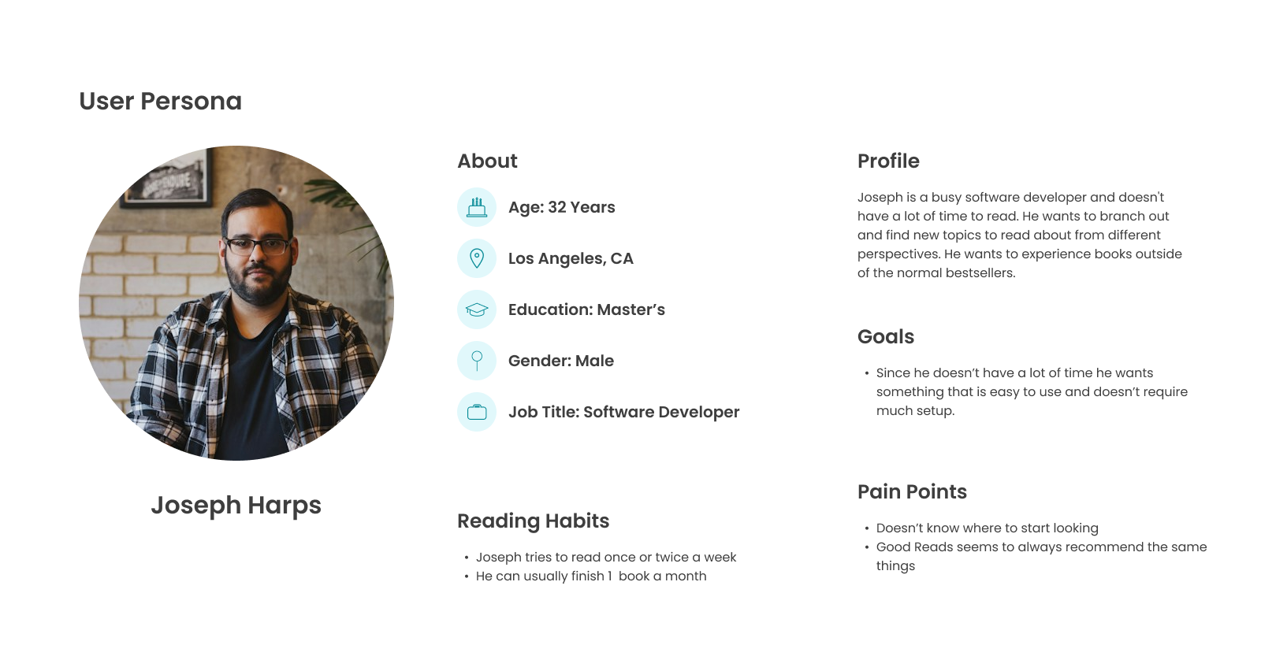

Slide 13
Minimum Viable Product
Our MVP will consist of the following functionalities:
Registration/Login
Book Recommendations
Book Collections for User
Marketplace Functionality

Slide 14
Technologies and Algorithm

Slide 15




Front End Technologies
We will be using the React JS library to create our UI along with some HTML and CSS as well.
For our login/registration we will be using Google Firebase. They allow you to interact with it through an API

Slide 16




Back End Technologies
We are using PyTorch for our ML Algorithm
We will create an API for the algorithm using Python
The backend will be written in Java using the Spring Framework
Our Database will be Postgres

Slide 17
Machine Learning Algorithm
Feature Vector Construction:
Represent each book as a vector of features. Each dimension corresponds to a specific characteristic or keyword associated with the book. For textual features, use techniques like TF-IDF to weight the importance of each word or tag.
2. Cosine Similarity Calculation:
Calculate the cosine of the angle between two book vectors, A and B, using the formula: Cosine Similarity = (A⋅B)/‖A‖‖B‖
Where:
A⋅B is the dot product of vectors A and B ‖A‖ and ∥B∥ are the magnitudes (Euclidean norms) of vectors A and B, respectively.
3. Interpretation:
The cosine similarity ranges from -1 to 1, where 1 means identical, 0 indicates orthogonality (no similarity), and -1 implies opposite. For book recommendations, we focus on positive similarity scores, with higher scores indicating greater similarity.
4. Recommendation:
For a target book, calculate its cosine similarity with all other books in the dataset. Recommend books with the highest similarity scores to the reader.

Slide 18
Diagrams

Slide 19
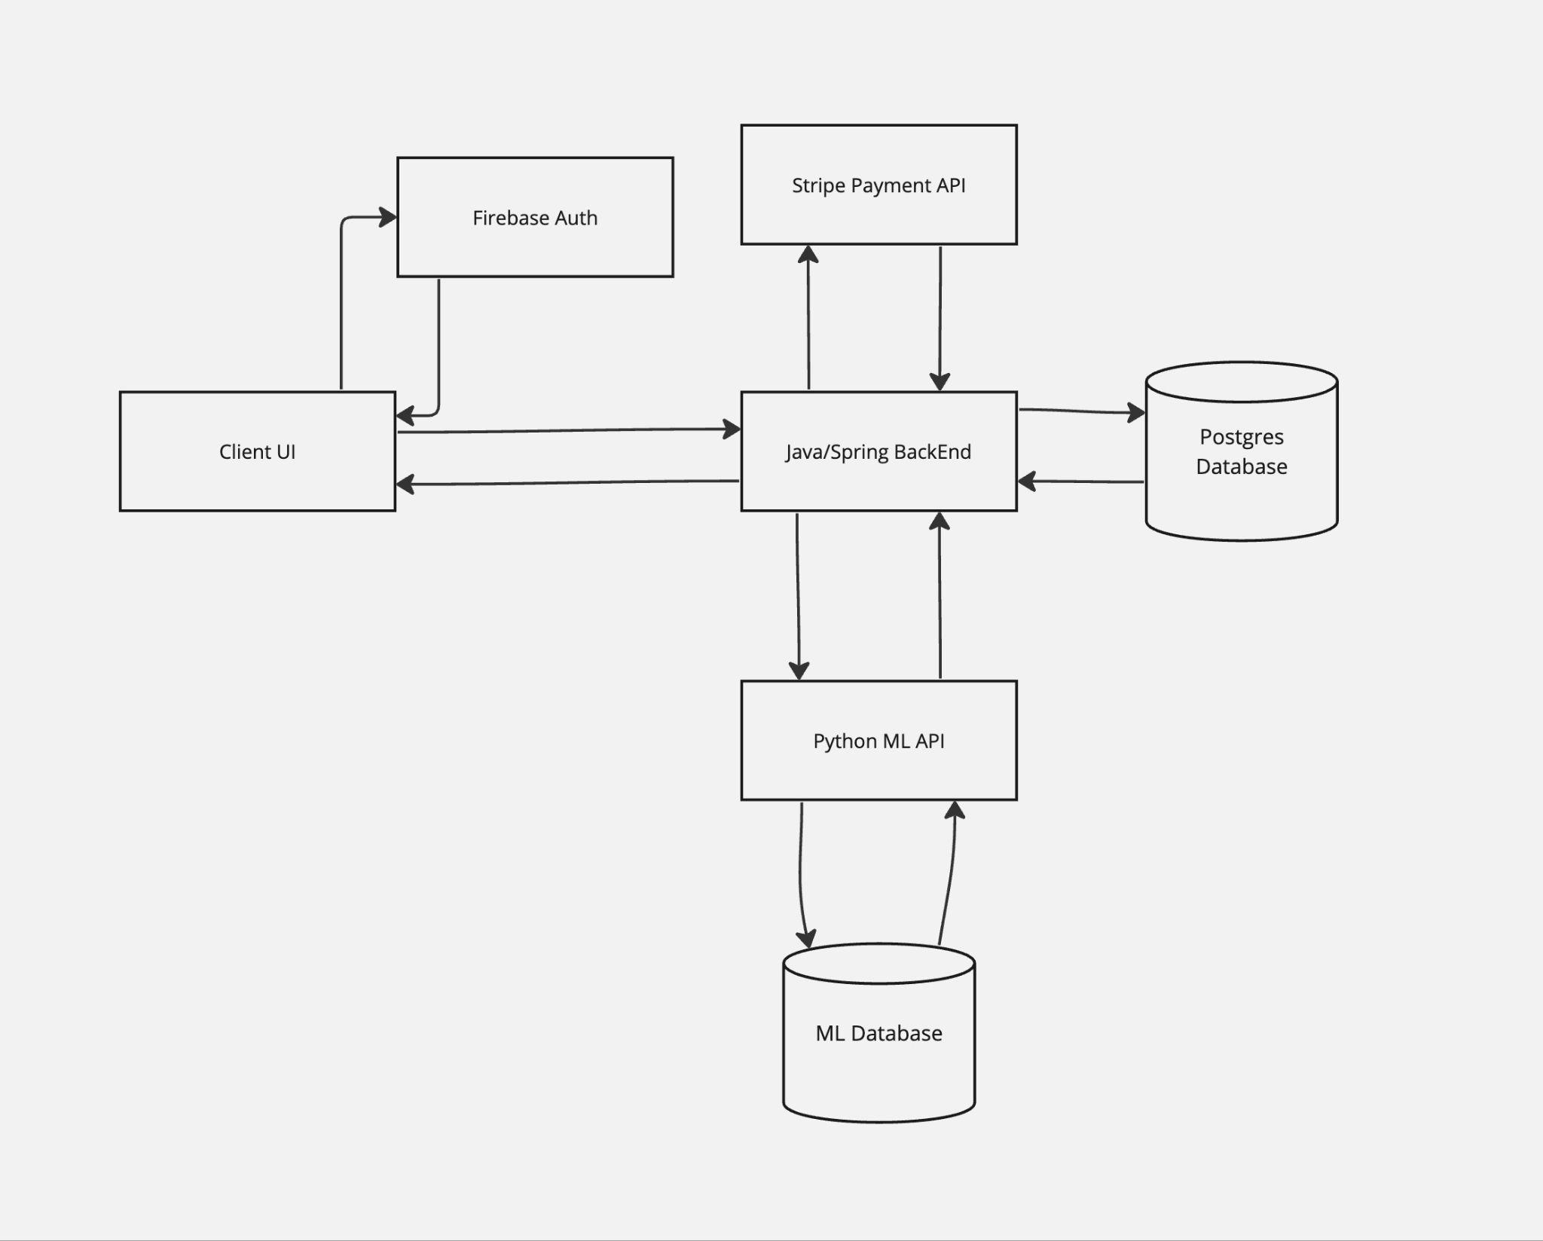
Conceptual Architecture Diagram

Slide 20
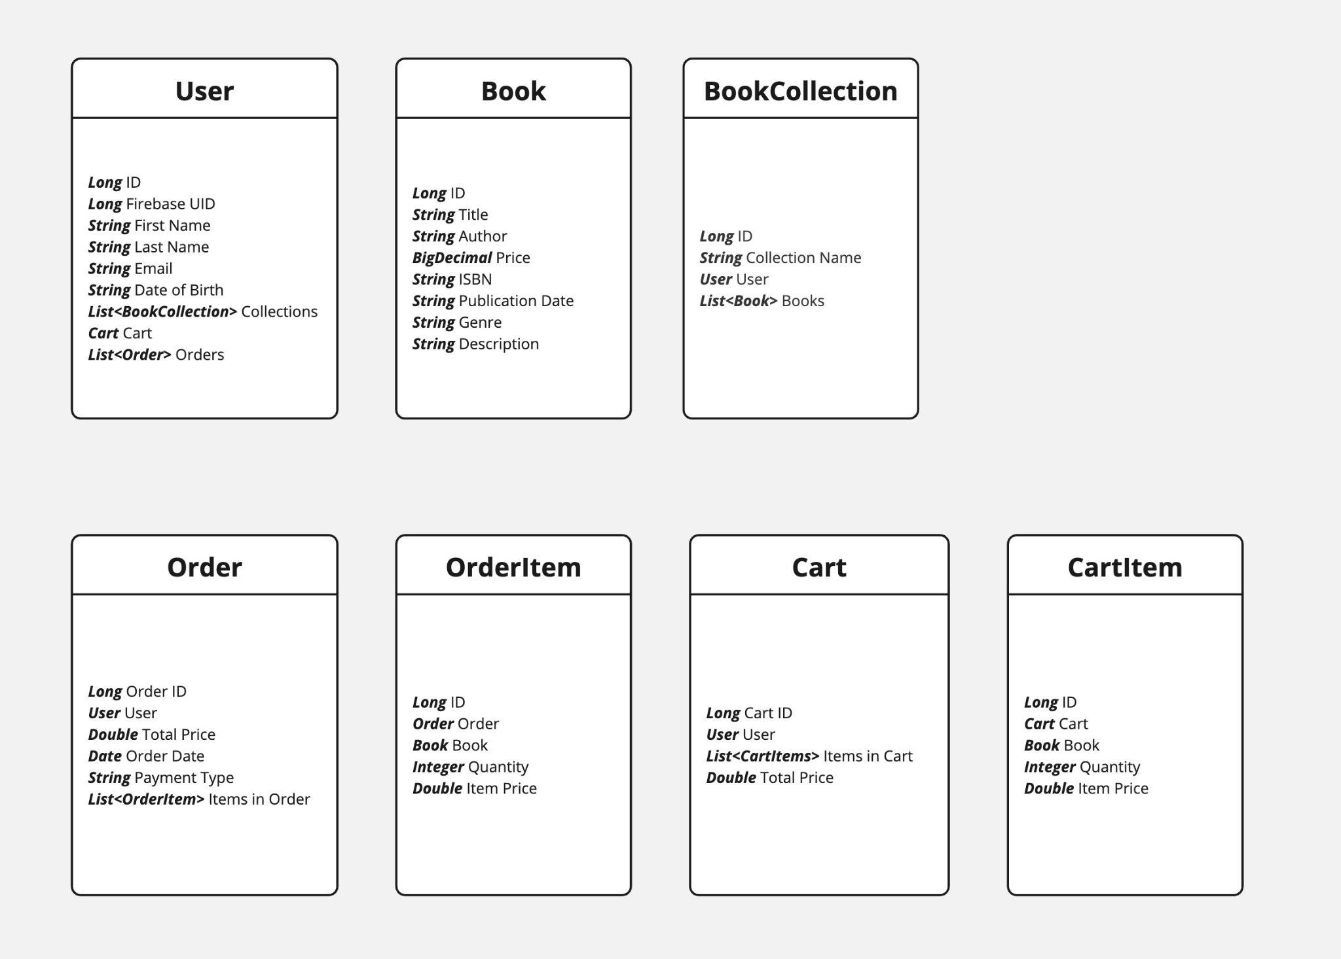
Class Diagram

Slide 21
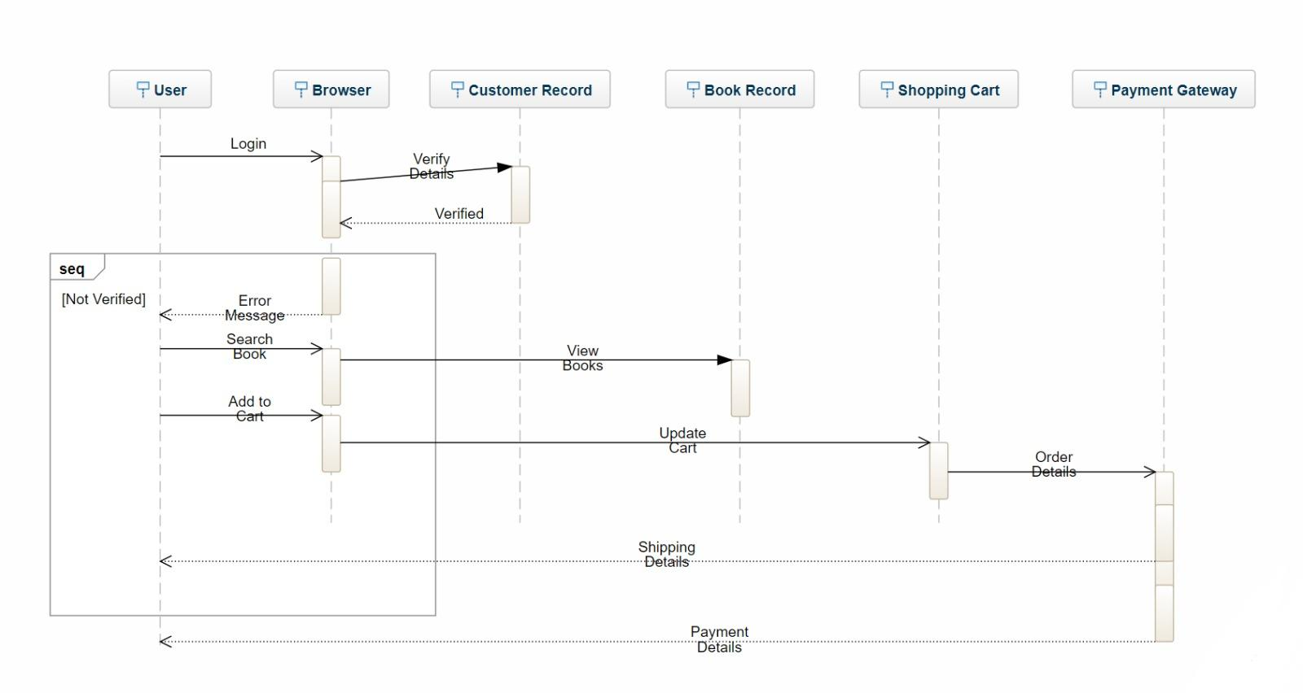
Sequence Diagram

Slide 22
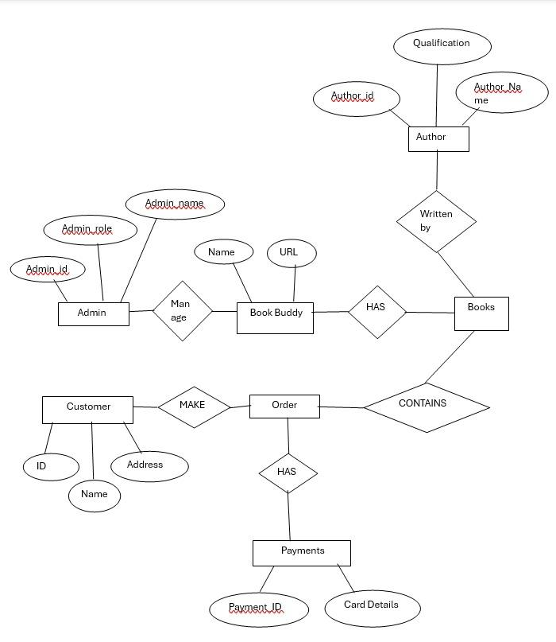
Entity Relationship Diagram

Slide 23
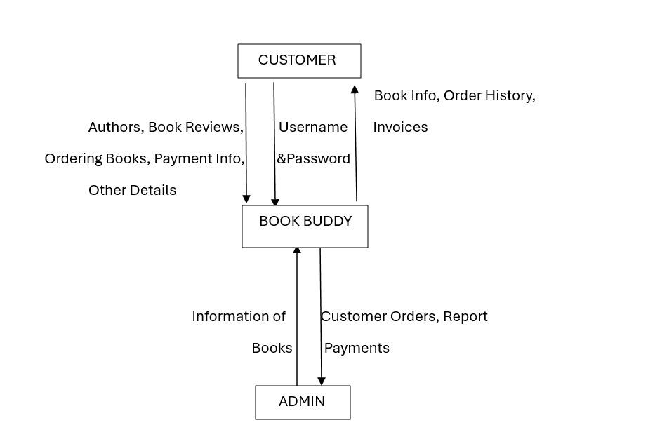
Context Diagram

Slide 24
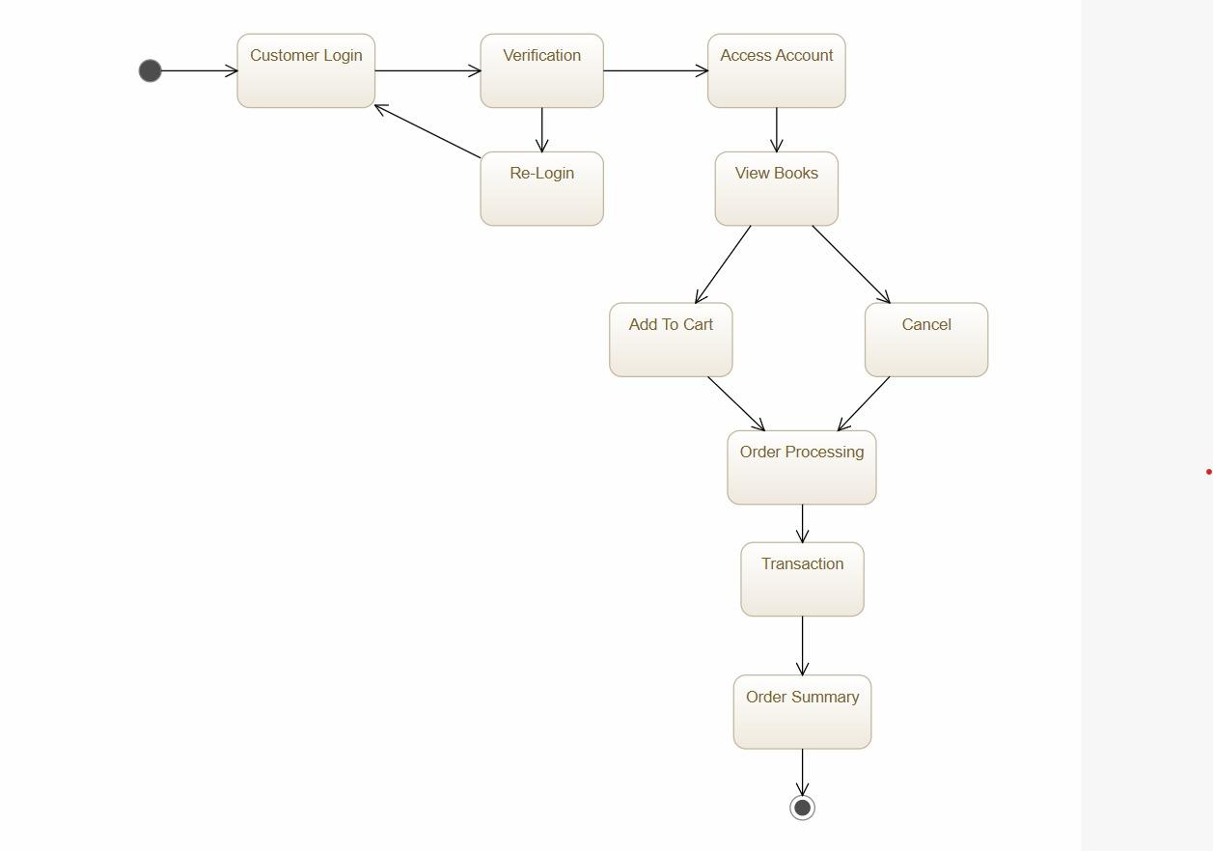
State Diagram

Slide 25
Sprint 2 Recap

Slide 26
Found ML dataset and tested algorithm
Designed main UI and UX for homepage
Finished experimenting with backend classes
Finalized project design
Finalized project architecture
Completed 27 story points out of 31 total points
87% Completed/Committed Ratio

Slide 27
Product Backlog

Slide 28
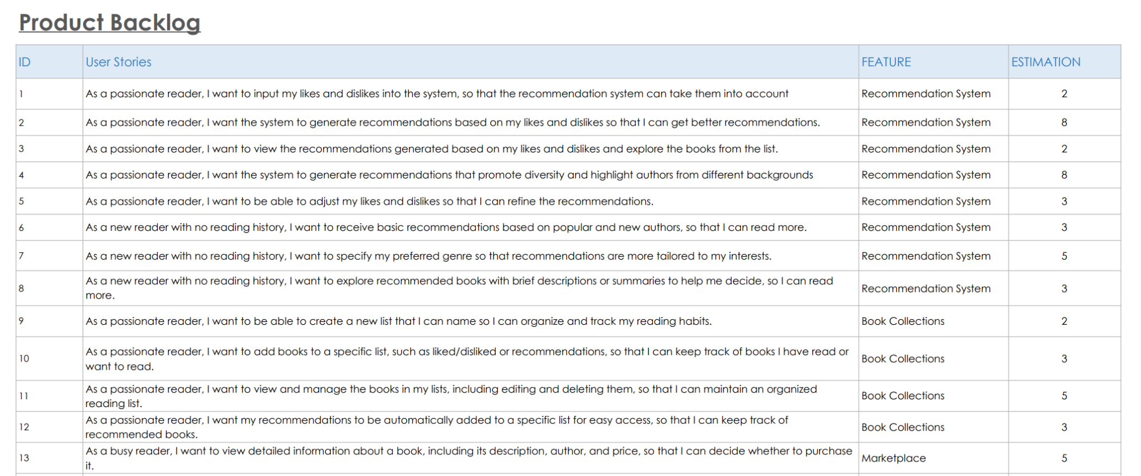

Slide 29
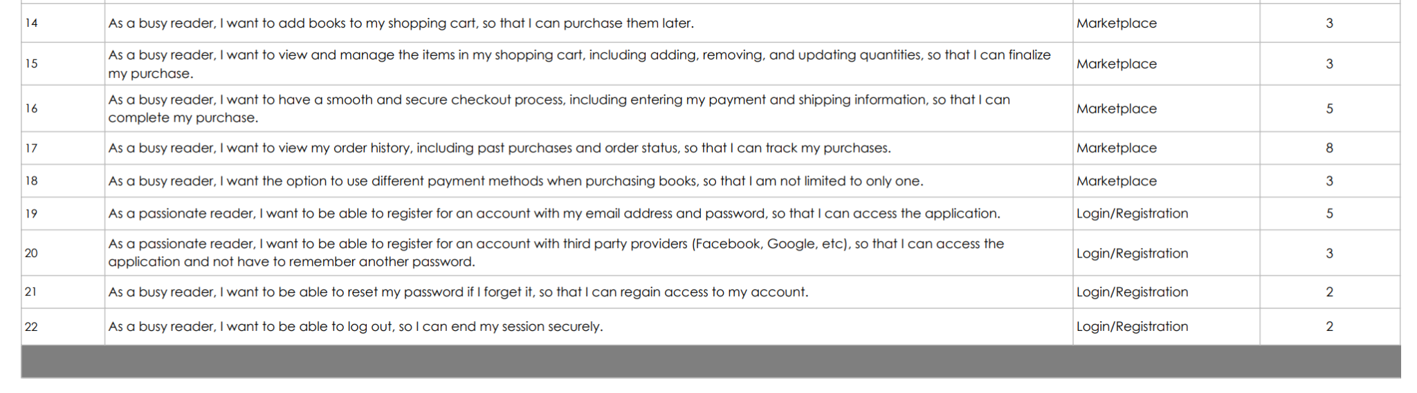

Slide 30
Sprint 3 Backlog

Slide 31
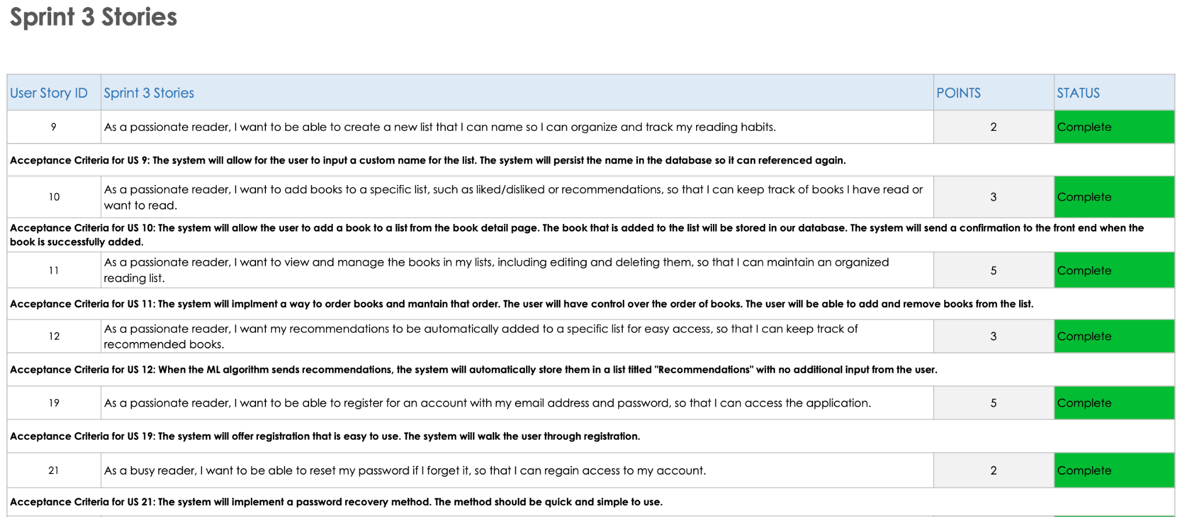

Slide 32
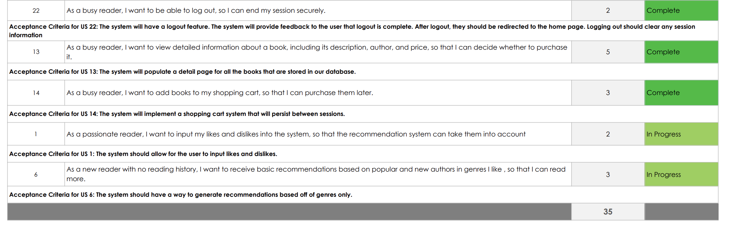

Slide 33
Sprint 3 Test Cases

Slide 34
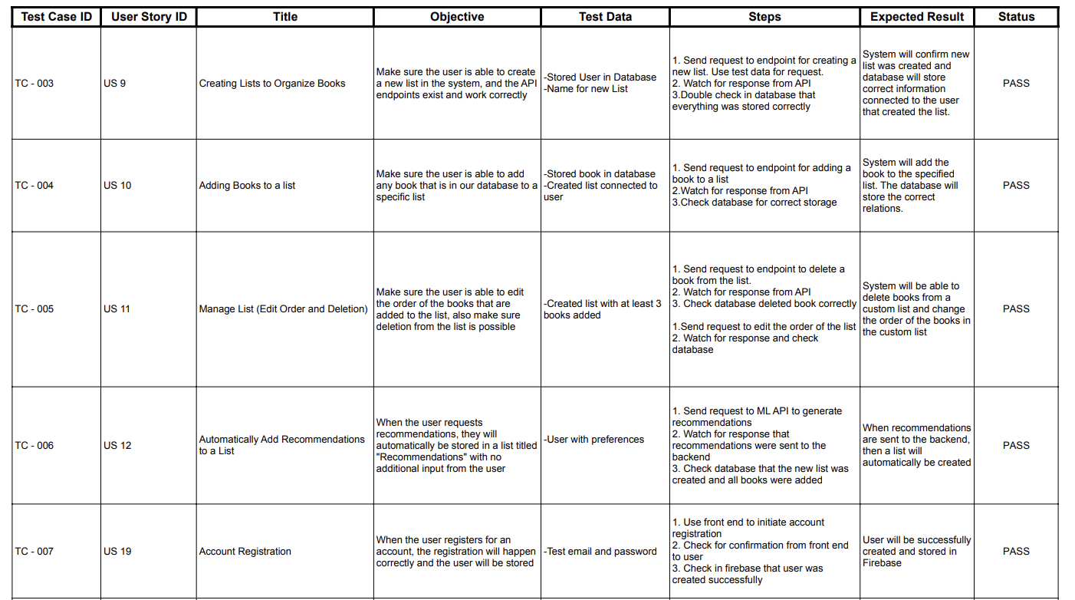

Slide 35
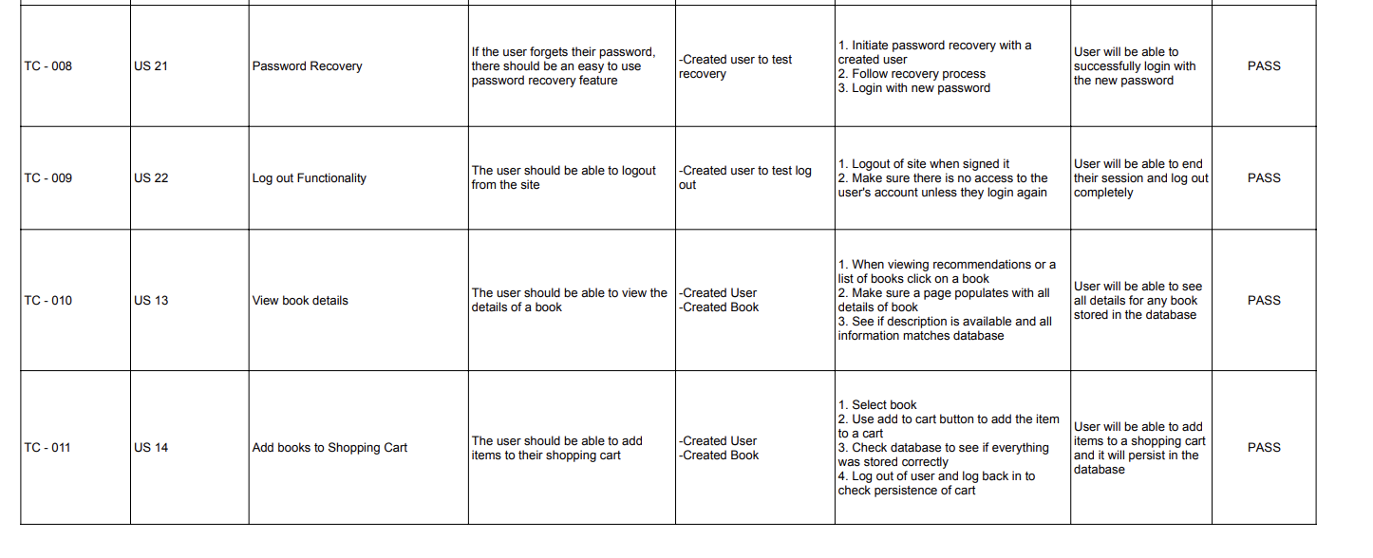

Slide 36
Sprint 3 Metrics and Charts

Slide 37
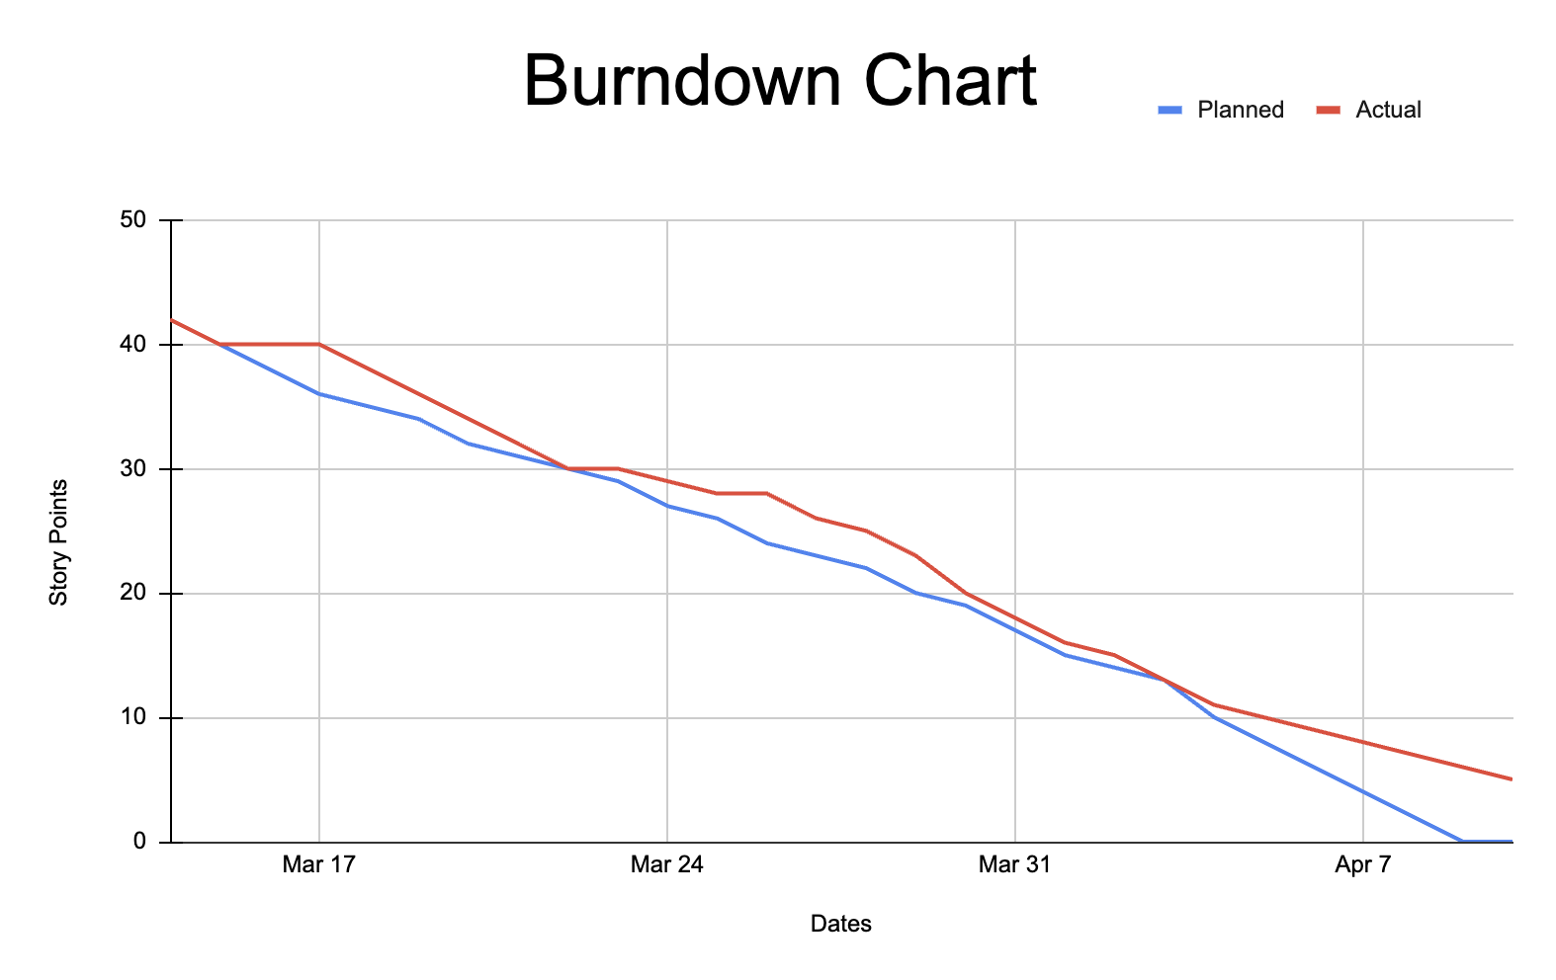
Team Velocity: 30 completed story points
Average Velocity: 29 story points
Completed Committed Ratio for Sprint 3: 30/35 - 85%

Slide 38
Sprint 3 Retrospective

Slide 39
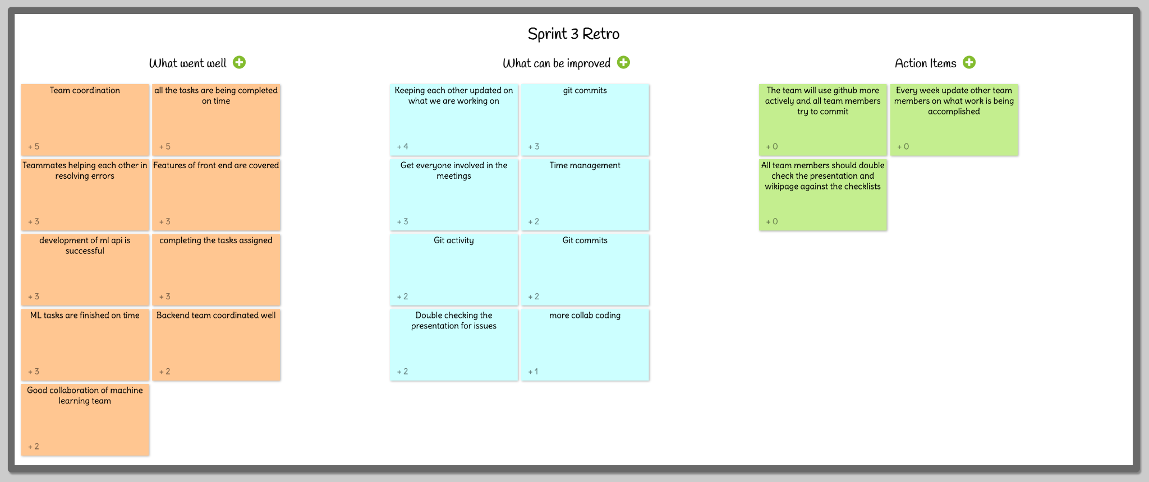

Slide 40
Sprint 4 Plans

Slide 41
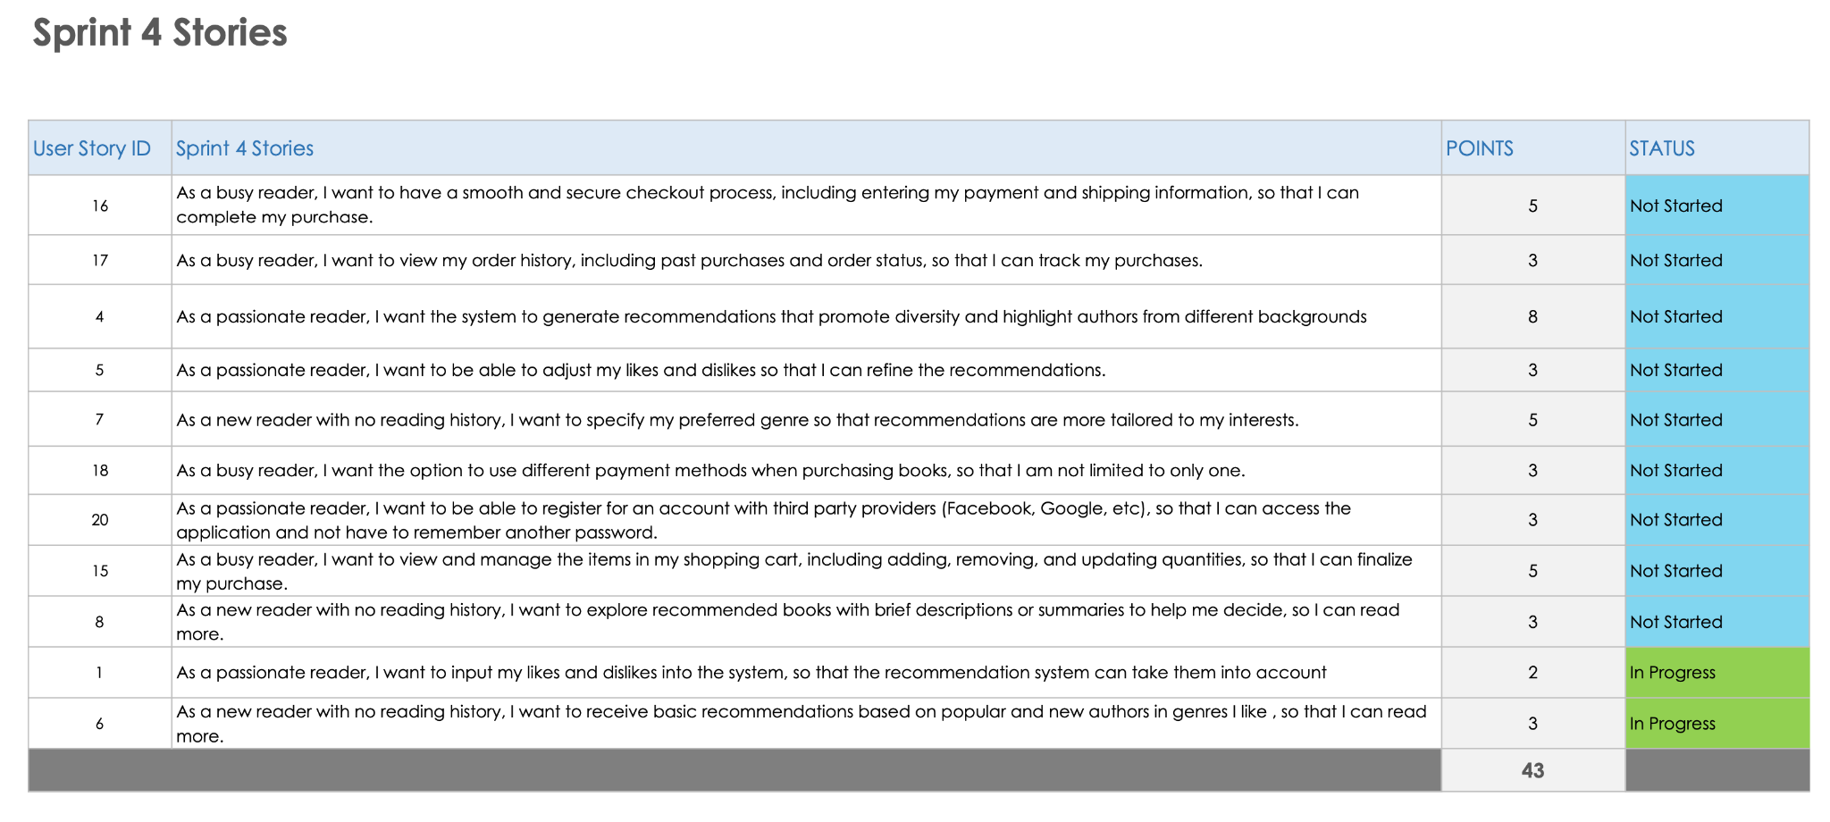

Slide 42
Project Demo for Sprint 3

Slide 43
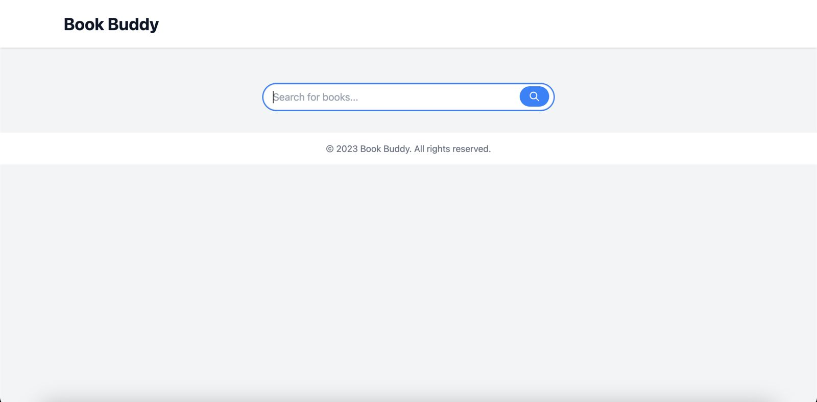
Demo Screenshots

Slide 44
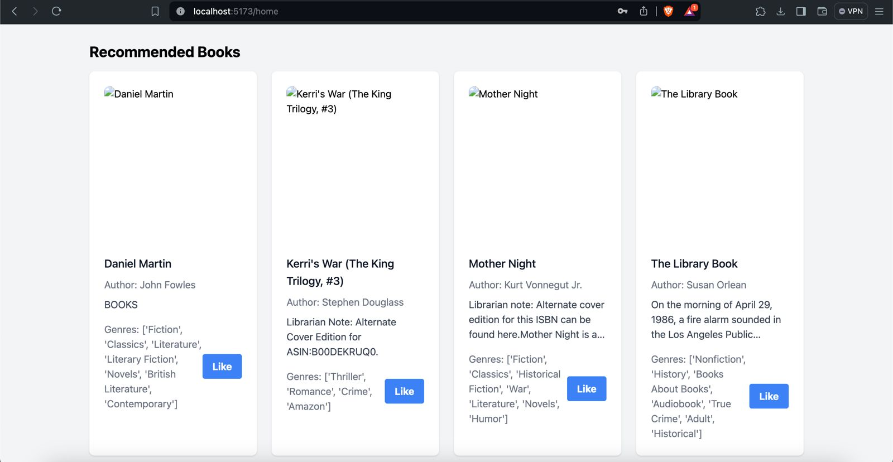

Slide 45
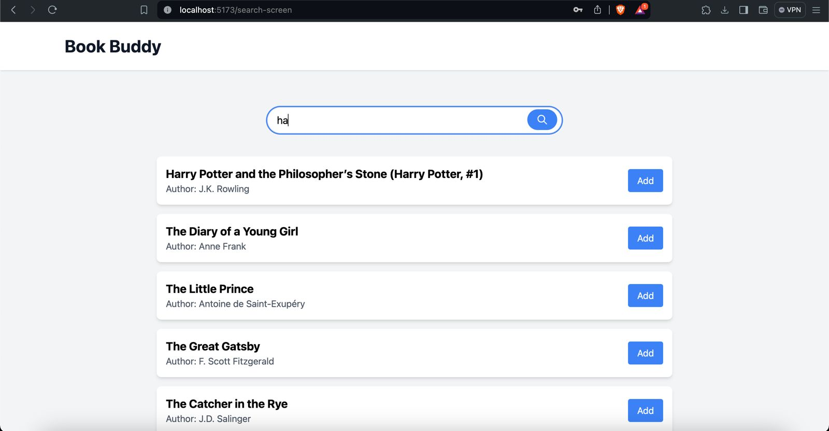

Slide 46
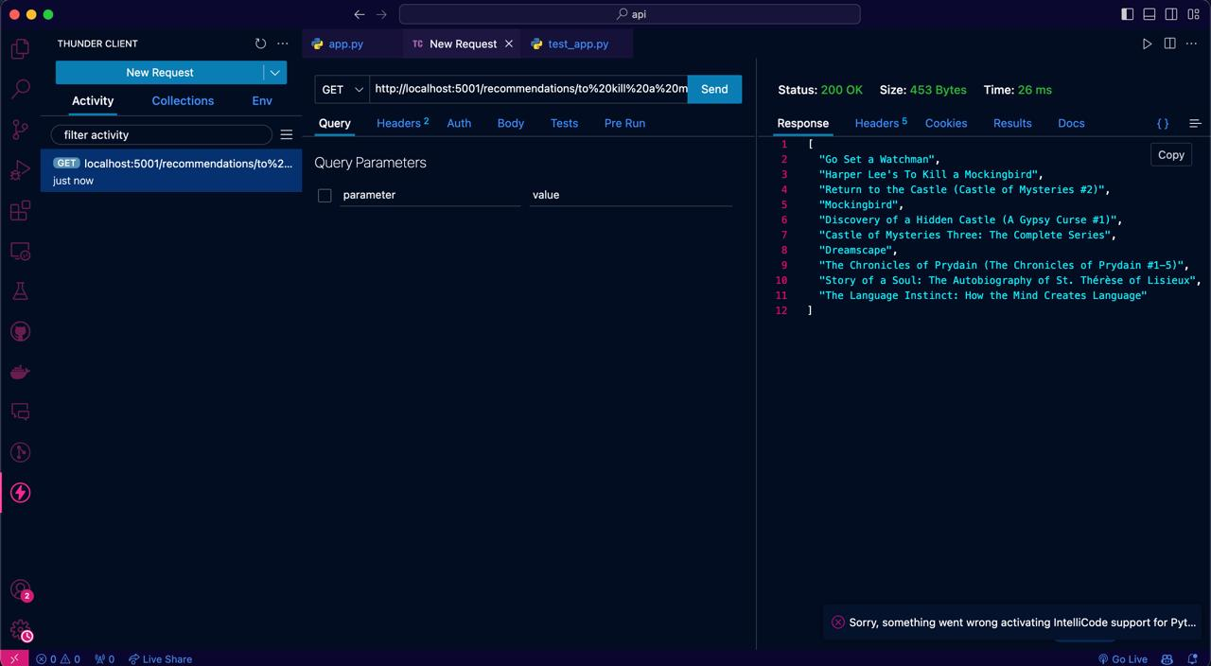
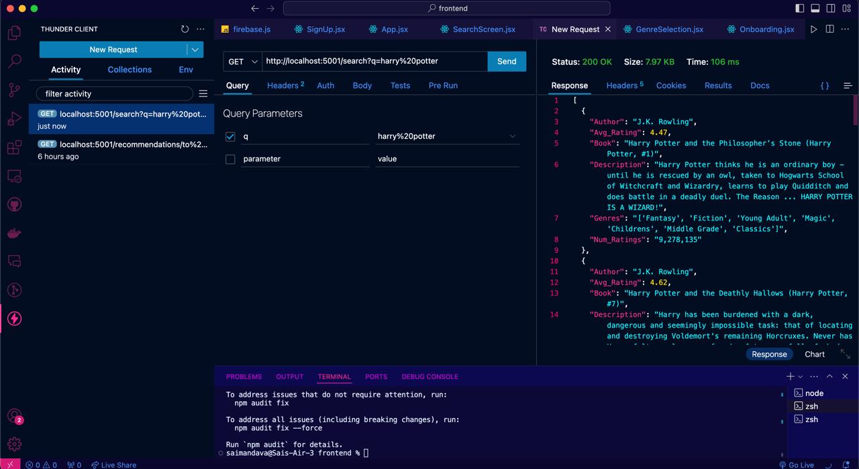
Machine Learning API
We have two routes in our ML API
We can generate recommendations based off a book
We can also search for a book in our dataset

Slide 47
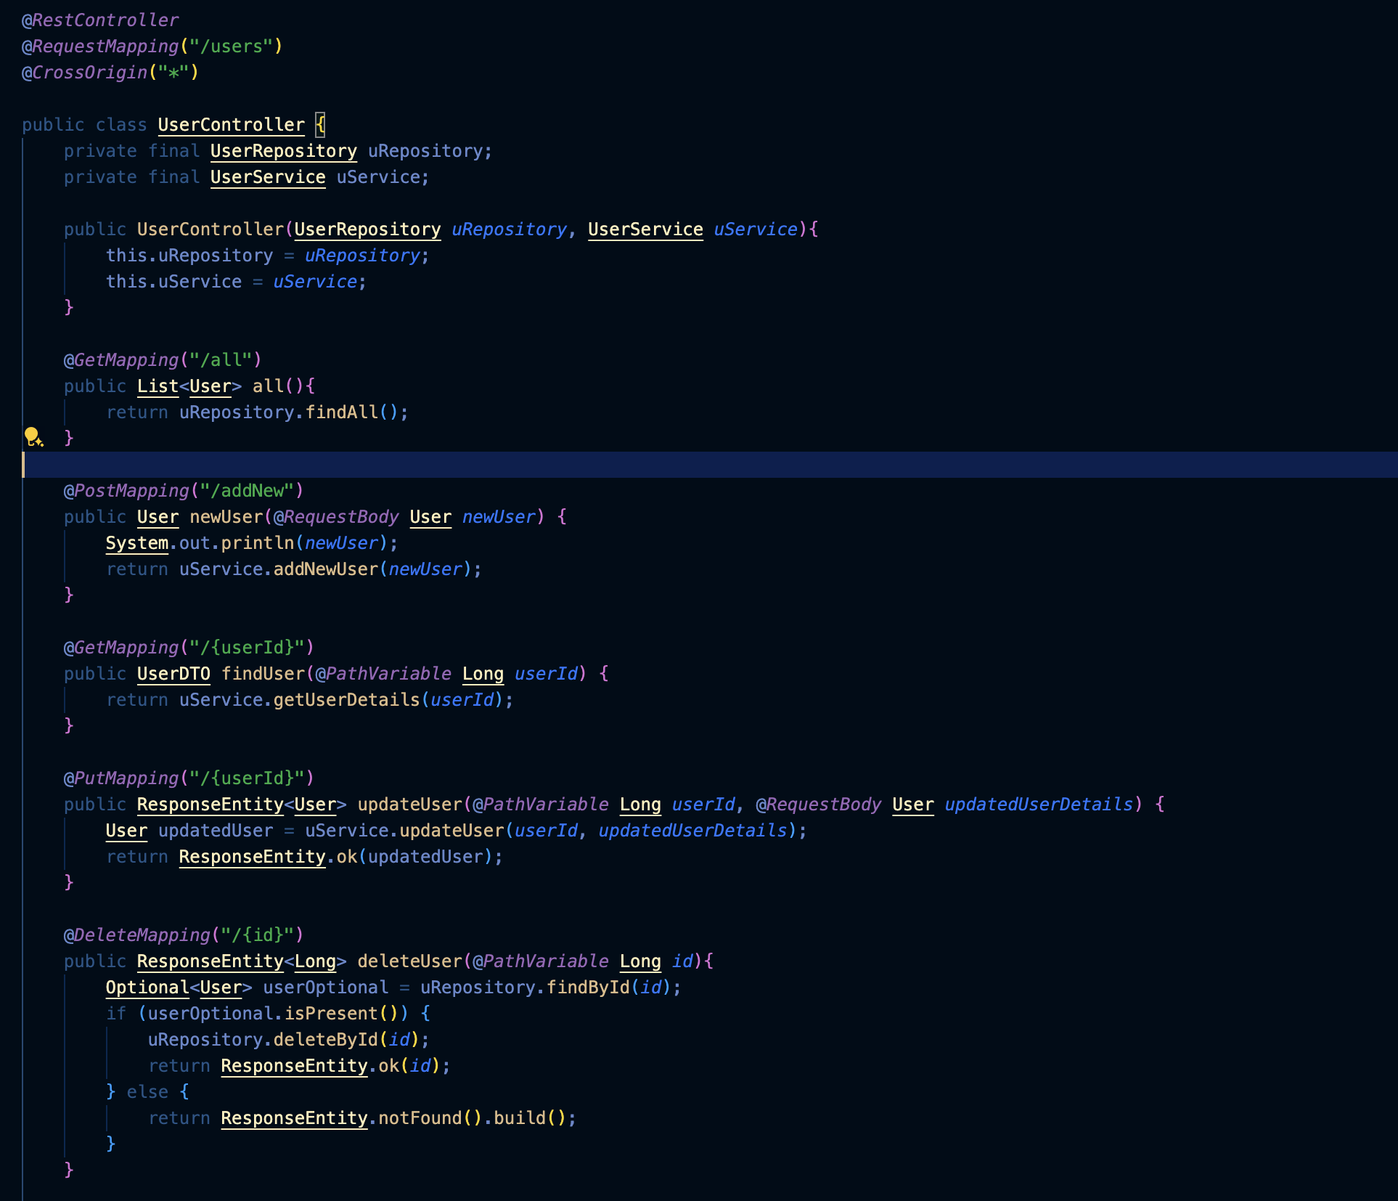
Backend API - User Management
Code Snippet of the User Controller
Shows all CRUD routes for User Management
Using User Data Transfer Object to display user details

Slide 48
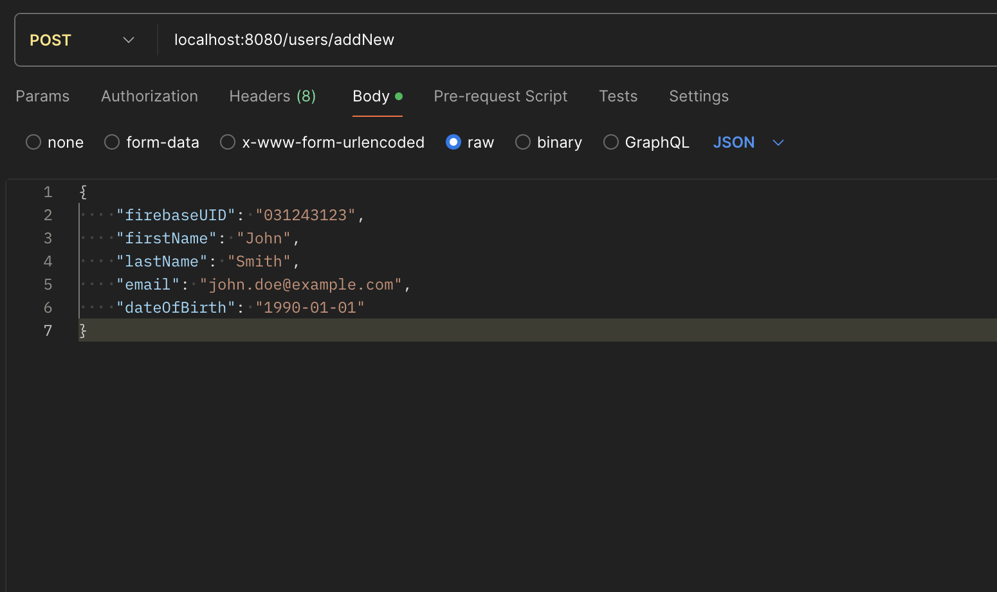
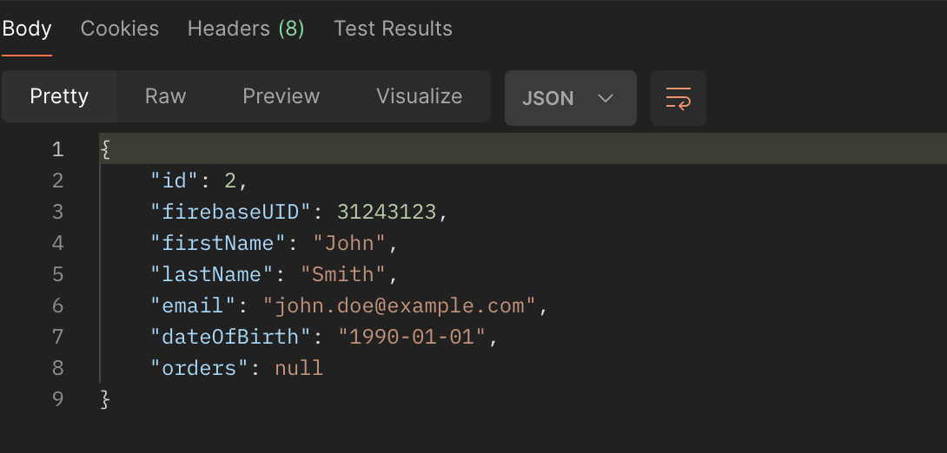
User Creation Route Testing
Route testing in Postman
The route take a new user in the form of a user object in the request body
When the user is stored in the database a unique id is generated and the new user object is returned to the client

Slide 49
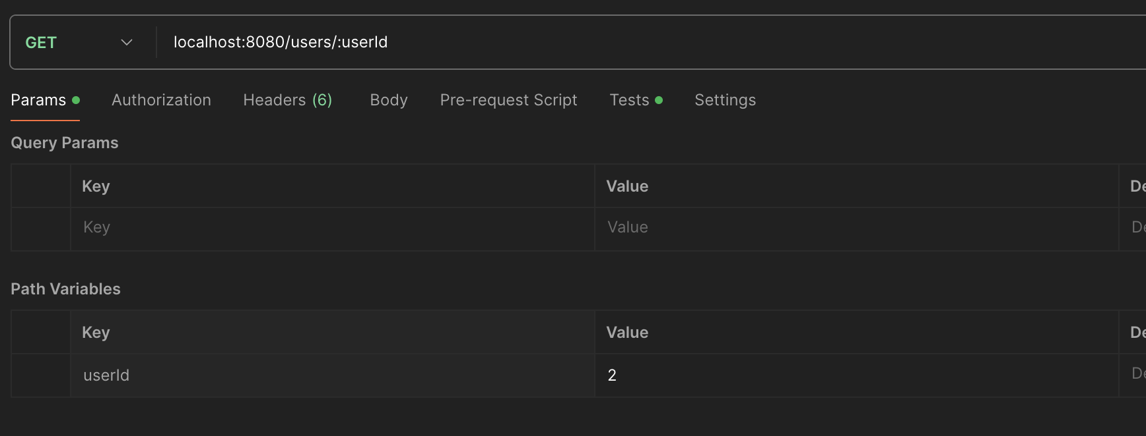
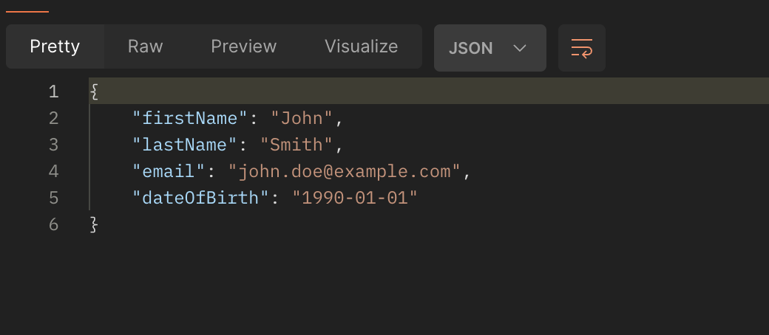
GET User Route Testing
The route takes one path variable which is the user id
This route will be used for populating basic details about the user. When using this route we return a User Data Transfer Object which removes the FirebaseUID and the Database ID since this information will never be displayed to the user

Slide 50
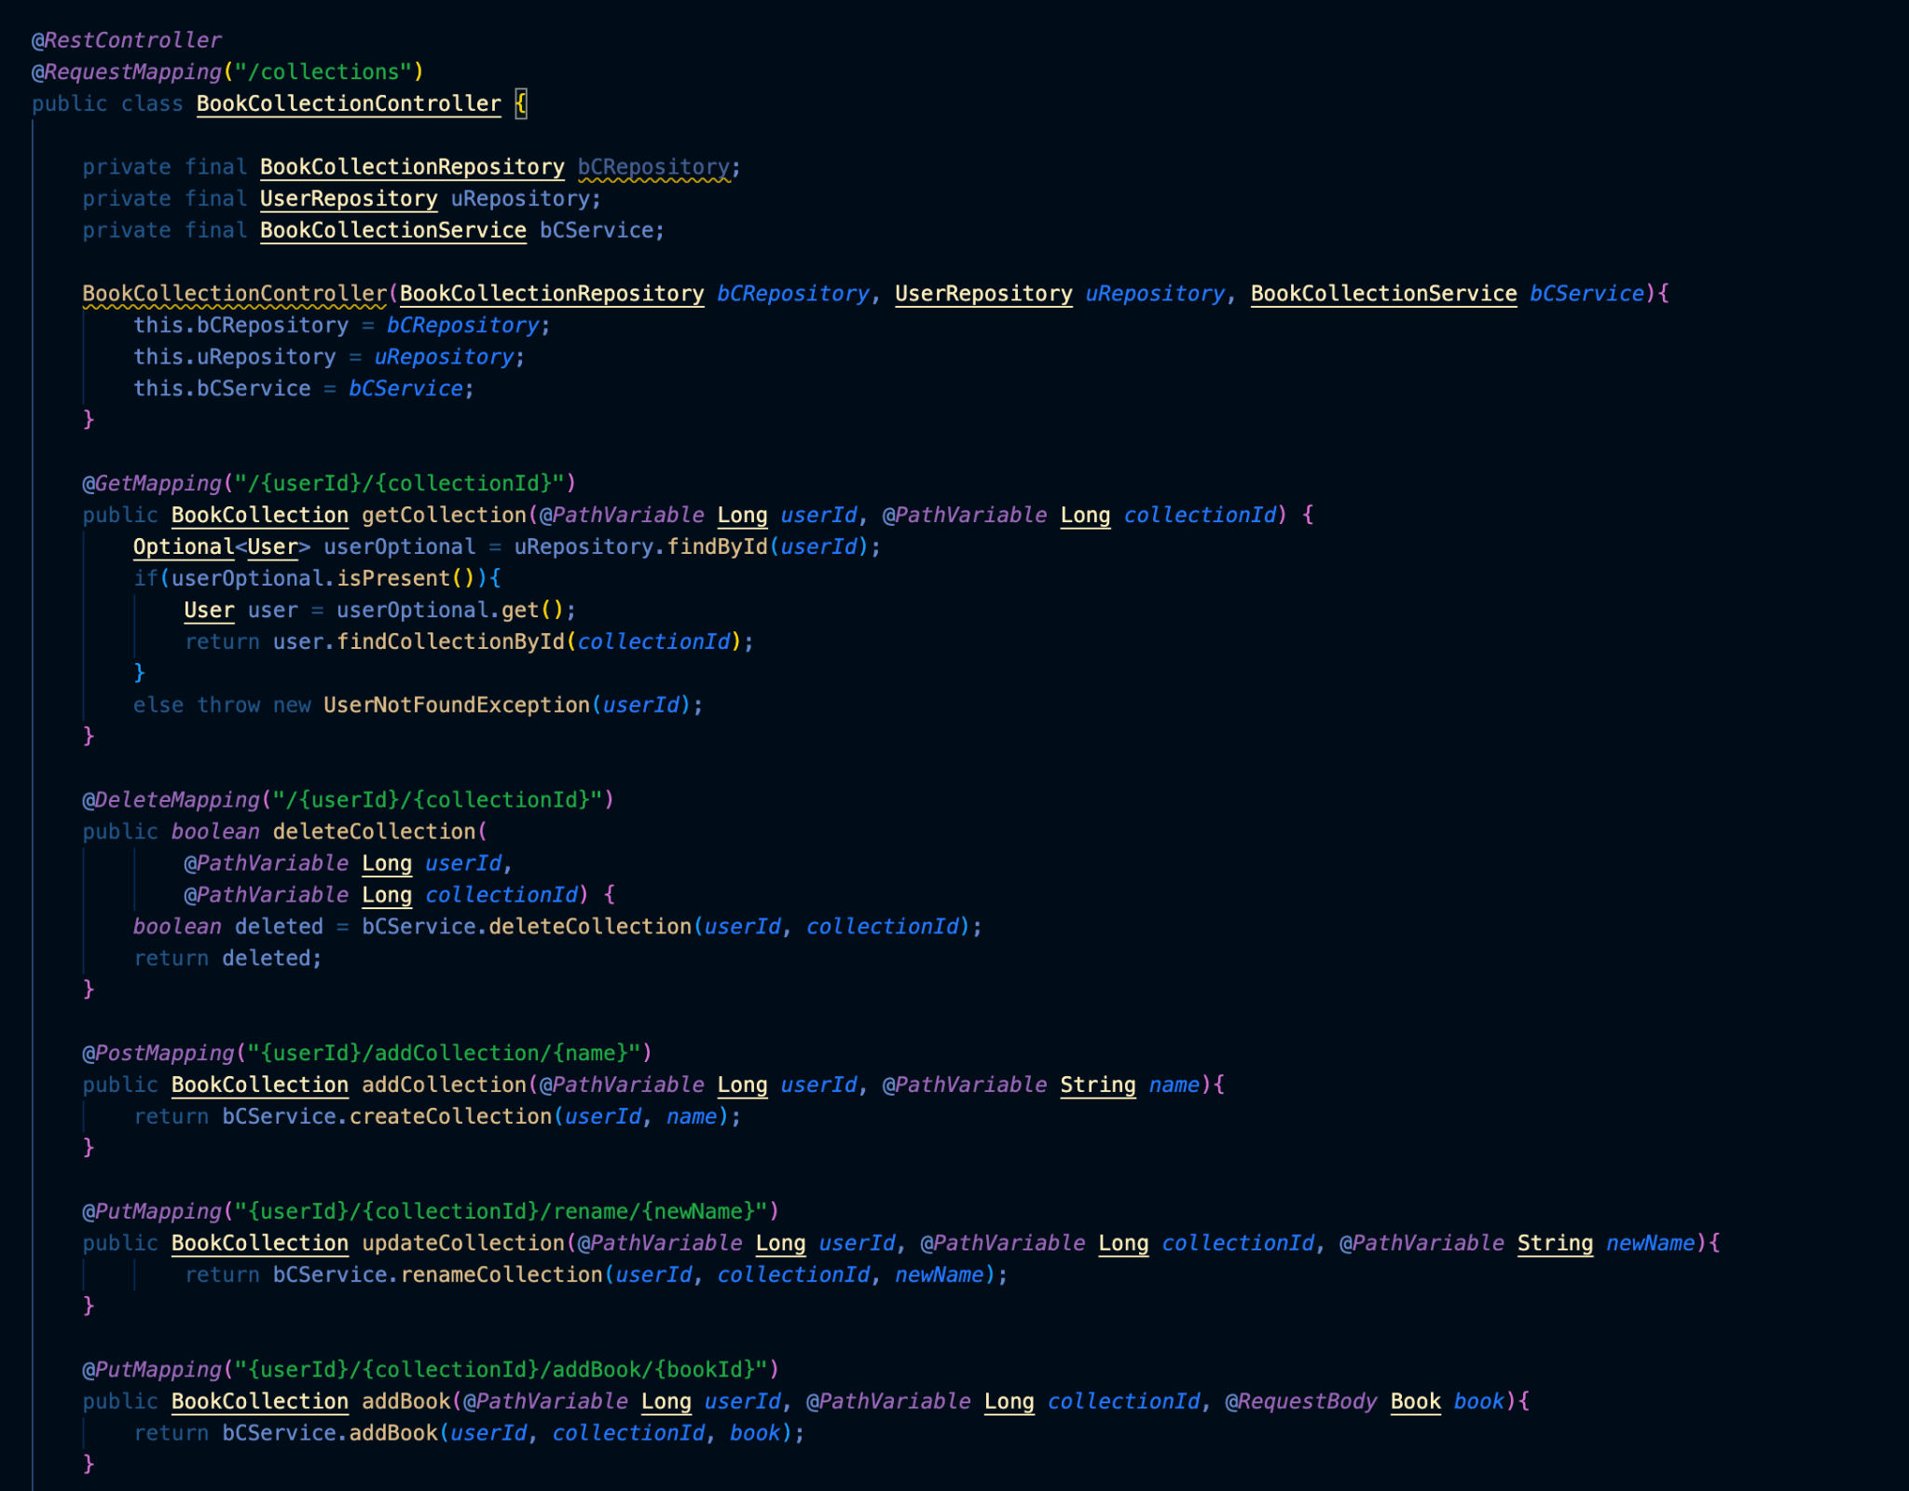
Backend API - Book Collection Management
These are the CRUD routes for Book Collections
These allow the user to create, edit and delete custom book collections

Slide 51
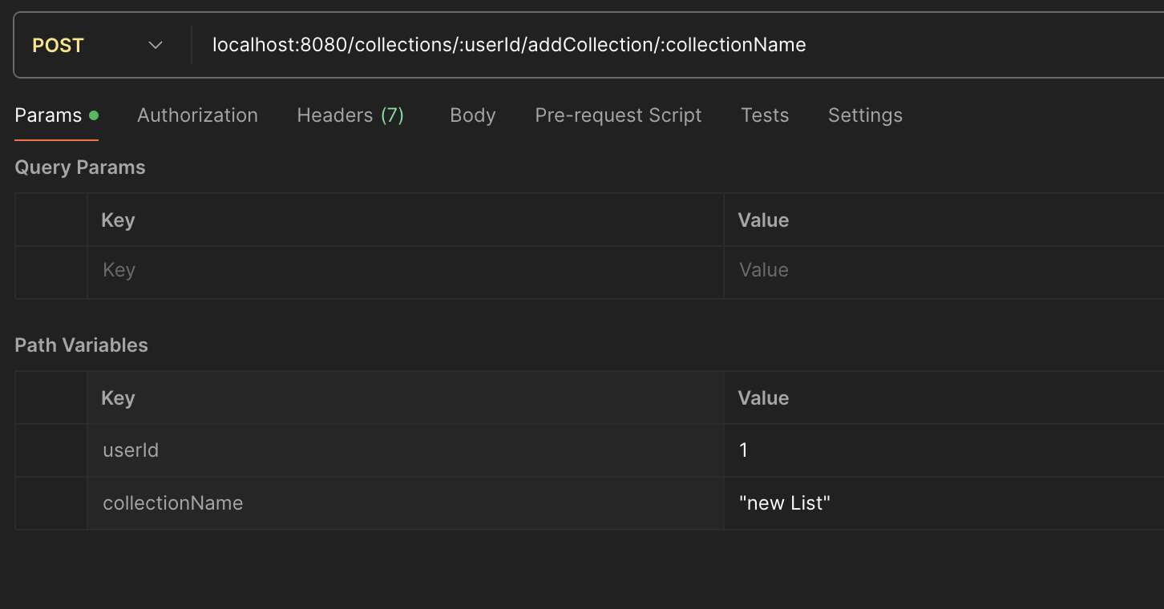
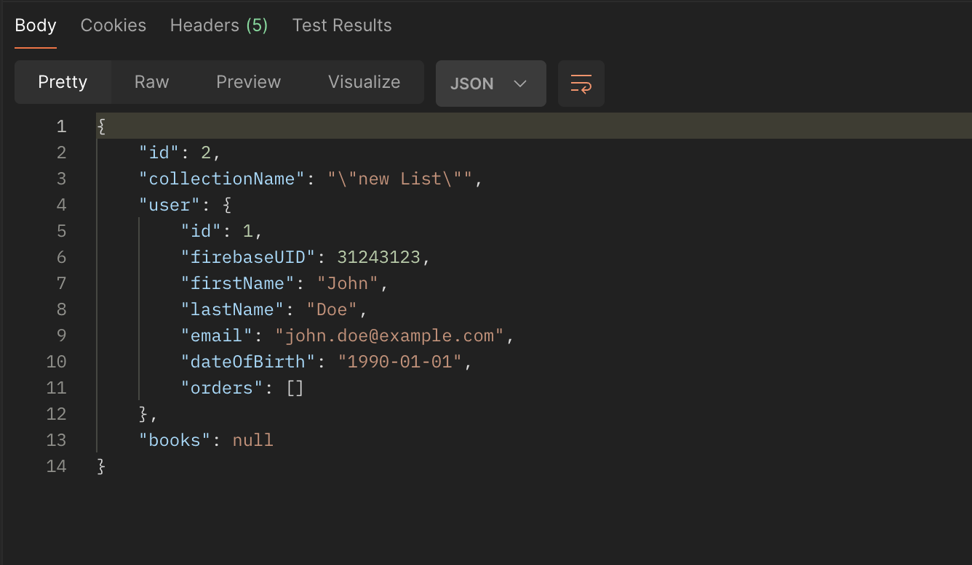
Create Collection Route Testing
This route allows the user to create a new book collection.
There are two path variables: user id and the name the user wants to give to the collection
The system sends the newly created collection along with the user who created it back to the client for display

Slide 52
WikiPage Link
https://github.com/htmw/2024S-Code-Avengers/wiki

Slide 53
Application Demo

